Slide 1
Quantitative Research Methods
March 20, 2023
Professor Patrick Rebuschat
p.rebuschat@lancaster.ac.uk
Notes:
Section title slide.

Slide 2
Reminder from last week

Slide 3
Checking for normality
Two basic ways:
Visual inspection (with graphs) – quick but imprecise
Statistical test for normality
I recommend you do both – it’s part of exploring your data set before running inferential statistics.

Slide 4
QQ-plots
This plots the quantiles of the observed data variable against the quantiles that we would expect if the data followed a normal distribution.
The observed data: Represented as white bubbles.
The expected data: A diagonal straight line
If the data distribution is approximately normal, then we expect the data points to sit more or less on top of the straight diagonal line; any deviation from it should be minor.

Slide 5
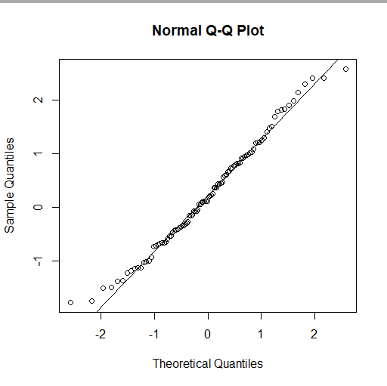
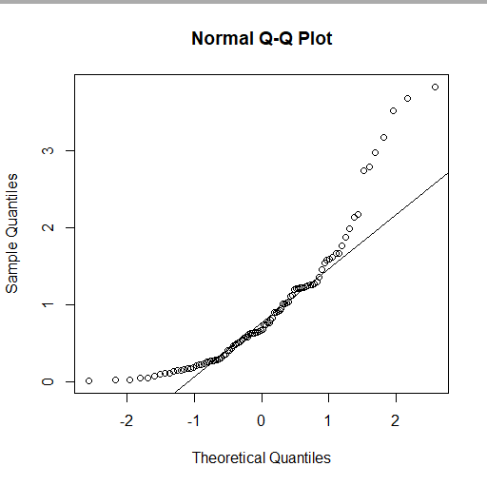
QQ-plots
Data drawn from non-normal distribution (Gamma distribution).
Data drawn from normal distribution.

Slide 6
Statistical test for normality
There are several tests that allow us to directly test whether our population data are likely to be normally distributed.
The Shapiro-Wilk’s test is widely recommended for normality test.

Slide 7
Parametric vs non-parametric tests
Most statistic tests are normally-distributed data. These are called parametric tests.
If your data is not normally distributed, you can use non-parametric tests. These do not make any assumptions about the distributions that the statistics of interest follow.

Slide 8
Variances
When using tests to check if different data sets have equal variances, we are actually trying to figure out if the population-level variances of the two groups are equal.
So it is not as easy as just saying that the variance of sample 1 is larger or smaller than the variance of sample 2.
Common tests: F-ratio, Bartlett’s test (for normally distributed data) or Levene’s test (for data that is not normally distributed).

Slide 9
Significance testing for continuous data
Tests for two groups: t-tests and related
Tests for more than two groups: ANOVA and related

Slide 10
Information to report
Example: t-test
Test statistic: t-value
degrees of freedom
p-value
Example: ANOVA
Test statistic: F-value
degrees of freedom (between and within)
p-value
We could report the result of the significance test as follows, following APA style. “An independent samples t-test showed that the difference betweeen groups was not significant, t(198) = -0.80019, p-value = 0.4246.” (The degrees of freedom are in the parentheses.)
Note: APA guidelines say we can round p-values to two or three decimals. Here, the actual value was p = .2123, so I rounded this to p = .212.
A note on scientific notation and funny-looking p-values
When working with R, as we saw with an example earlier, you may sometimes get a very funny-looking p-value like the one below.

Slide 11
Example of how you might write-up an ANOVA test result
“The mean score on the maths exam was 55.97 (SD = 11.21) for language group A, M = 60.24 (SD = 20.28) for language group B, and M = 81.89 (SD = 20.24) for language group C. Our calculation of Cohen’s d to measure the difference between the three means revealed a large effect, d = 1.553. A one-way ANOVA demonstrated that the effect of native language on maths scores was significant, F(2, 197) = 40.23, p < .001. Post-doc comparisons using Tukey’s HSD test further revealed a significant difference between language group A and C, M_{diff} = 25.92, p < .001, and between language group B and C, M_{diff} = 25.92, p < .001. The difference between language groups A and B was not significant, M_{diff} = 4.27, p = .374. In other words, speakers of language C clearly outperformed the speakers of languages A and B in the maths exam.”

Slide 12
Correlations and linear regression

Slide 13
Correlations
A measure of the existence and magnitude of a relationship between two variables.
A positive correlation tells us that the two variables go up in step with each other, as in the example in the graph above.
A negative (or inverse) correlation tells us that, as one variable goes up, the other one goes down.

Slide 14
How to interpret correlation coefficients
Statistical tests:
Pearson’s r
Spearman’s rho (ρ)
Kendall’s tau (τ)
0 to ± 0.1 = no relationship
± 0.1 to 0.3 = small relationship
± 0.3 to 0.5 = moderate relationship
± 0.5 to 1.0 = large relationship
±1 = a perfect correlation.
r = .75

Slide 15
Linear regression
Correlation: a (rough) measure of the existence and magnitude of a relationship between two variables.
It does not enable us to make actual predictions about other data values that have not been observed in our sample.
Neither does it allow us to characterize the relationship between the variables more explicitly in the form of a theoretical model equation.
For this, we need (linear) regression.
Notes:
Response duration as a function of word frequency; each point represents the average response duration for a particular word; the x-axis is scaled logarith- mically (see Chapter 5); the line represents the linear regression fit; the white square represents the intercept (the point where x = 0)

Slide 16
y = a + bx
Value y is the dependent (or outcome) variable
Value x is the independent (or predictor) variable.
Values a and b are known as the coefficients of the regression equation.
Coefficient a is the intercept, the point at which the regression line hits the vertical (y) axis, when x = 0.
Coefficient b is known as the slope of the regression line and determines how steep its gradient is.
Notes:
Response duration as a function of word frequency; each point represents the average response duration for a particular word; the x-axis is scaled logarith- mically (see Chapter 5); the line represents the linear regression fit; the white square represents the intercept (the point where x = 0)

Slide 17
Max.Price = -0.65 + (0.16 × Horsepower)
Max. price = outcome variable
Horsepower = predictor variable
Coefficients:
-0.65 = intercept
0.16 = slope
Line represents the linear regression fit
Notes:
Response duration as a function of word frequency; each point represents the average response duration for a particular word; the x-axis is scaled logarith- mically (see Chapter 5); the line represents the linear regression fit; the white square represents the intercept (the point where x = 0)

Slide 18
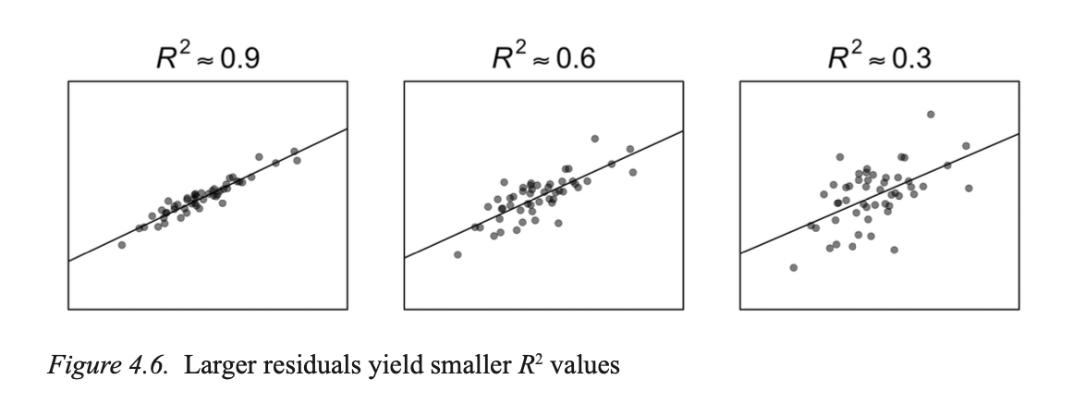
Linear regression
R² measures the strength of the relationship between two variables.
Values closer to 1 indicate a better model fit.
Great fit!
So-so fit
Notes:
Response duration as a function of word frequency; each point represents the average response duration for a particular word; the x-axis is scaled logarith- mically (see Chapter 5); the line represents the linear regression fit; the white square represents the intercept (the point where x = 0)

Slide 19
Test for categorical variables

Slide 20
Categorical variables
Raw frequency data, not means, “count data”.
How many individual cases fall into a set of categories.
Example:
Test scored on the basis of pass/fail, or letter grades used rather than numerical marks.

Slide 21
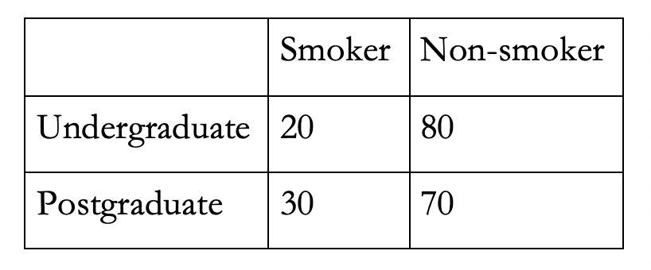
Contigency tables
Categorical data are normally represented in the form of a contingency table.
The smallest type of contingency table is a 2 x 2 table. That is, a table that represents two variables with two possible values each.

Slide 22
Statistical tests
Three different tests:
Pearson’s chi-squared test
Fisher’s exact text
Likelihood-ratio test

Slide 23
After our analyses

Slide 24
The PPDAC Cycle
Adapted from Spiegehalter (2019)
Understanding and clearly defining the problem
Deciding on strategy to answer the question(s)?
Interpretation
Conclusion
Dissemination
Sharing of data and scripts
New ideas
What to measure and how?
Study design?
Data collection methods?
Ethics approval
Preregistration?
PROBLEM
CONCLUSION
PLAN
Open and reproducible science
Exploratory data analysis
Visualization
Hypothesis testing
ANALYSIS
DATA
Collection
Management
Cleaning (from raw to tidy data)

Slide 25
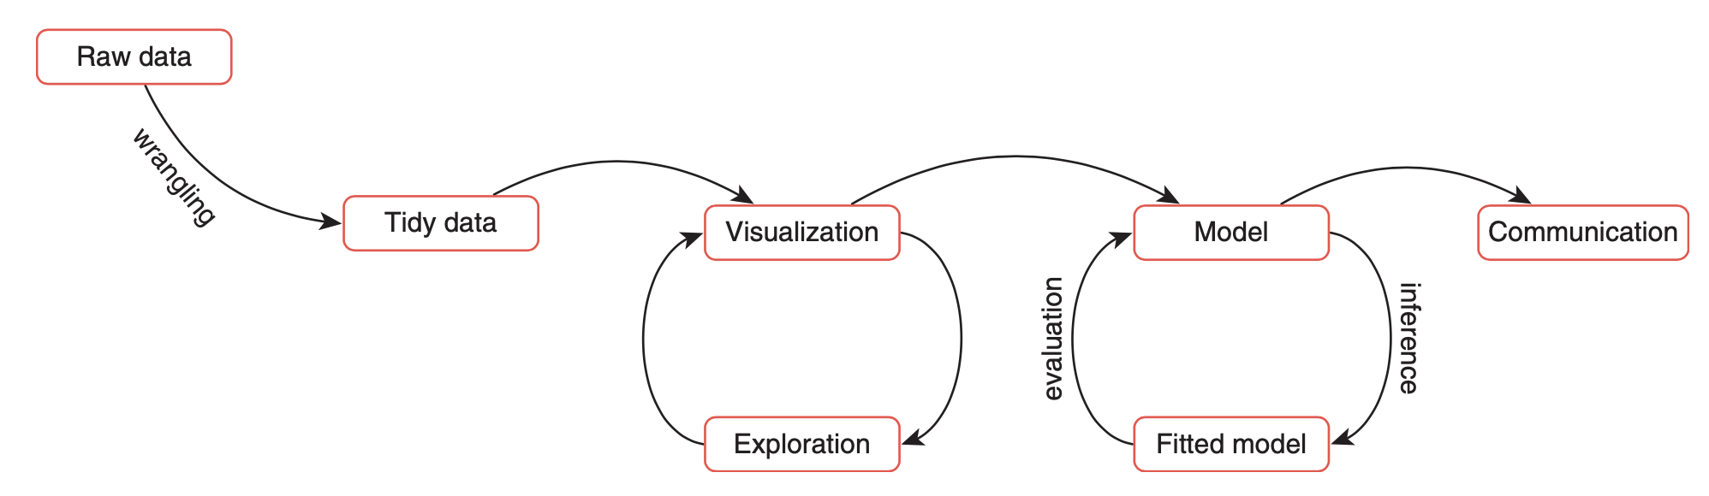
The Data Science Workflow
Reproduced from Andrews (2021)

Slide 26
Communication
We disseminate our results (e.g., presentations, publications, corpora).
But: Science should be open, transparent and reproducible, so we should also share materials, data and scripts via freely available platforms (e.g., OSF, IRIS).
This way, others can replicate our studies and build on our research.

Slide 27
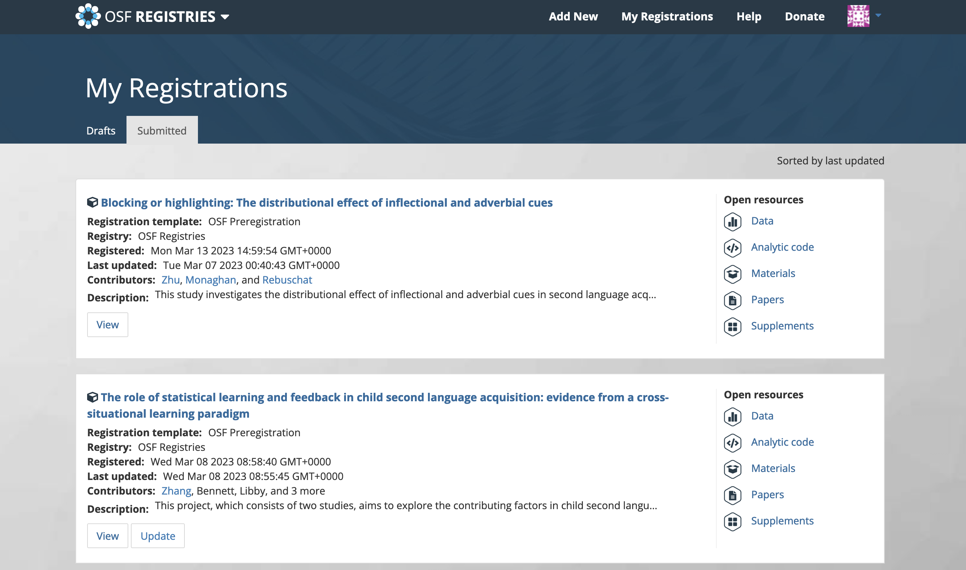
Preregistrations
Notes:
https://r4ds.had.co.nz/r-markdown.html
https://osf.io/2j6pe/

Slide 28
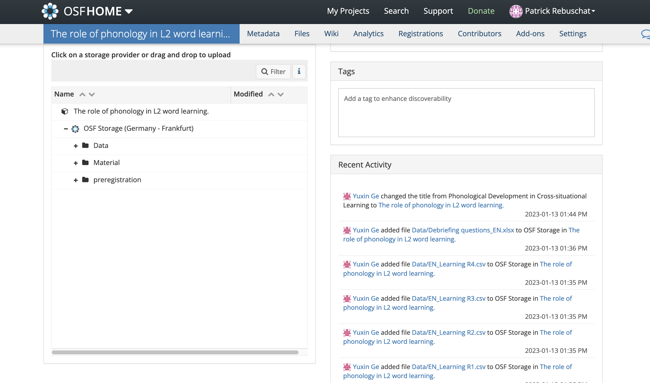
Sharing on
https://osf.io/2j6pe/
Notes:
https://r4ds.had.co.nz/r-markdown.html
https://osf.io/2j6pe/

Slide 29
R Markdown
A format for producing reproducible, dynamic reports with R.
Can be used to embed R code and results into slideshows, PDFs, html documents, Word files, etc.
Great way to share your data, analyses, results and interpretations.
Notes:
https://r4ds.had.co.nz/r-markdown.html

Slide 30
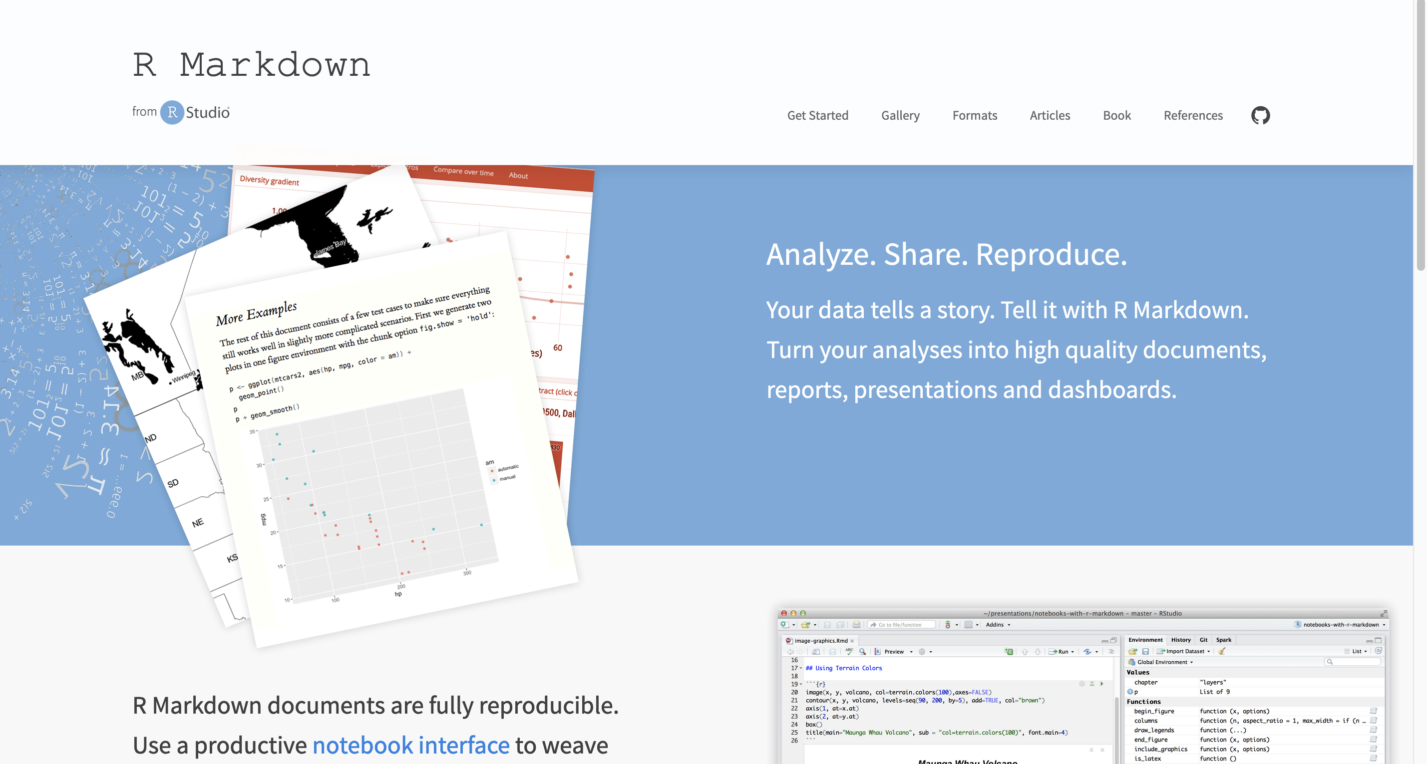
R Markdown (video)
https://rmarkdown.rstudio.com/index.html
Notes:
https://r4ds.had.co.nz/r-markdown.html

Slide 31
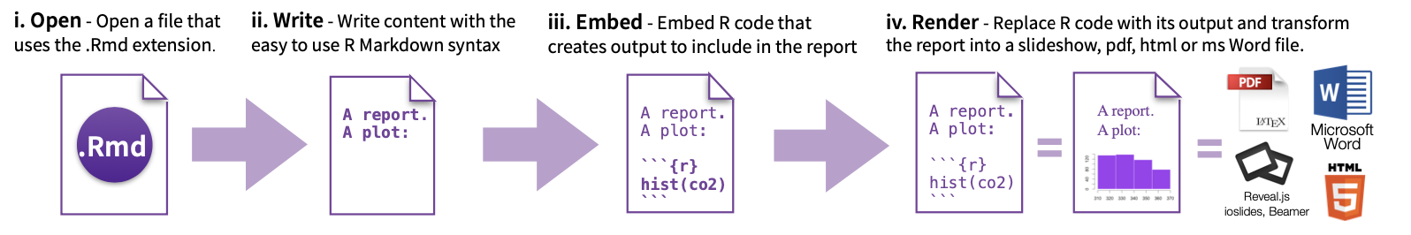
Workflow
https://rmarkdown.rstudio.com/index.html
Notes:
https://r4ds.had.co.nz/r-markdown.html

Slide 32
Questions?

Slide 33
Quantitative Research Methods
March 13, 2023
Professor Patrick Rebuschat
p.rebuschat@lancaster.ac.uk
Notes:
Section title slide.

